Slide 1

ACHARYA INSTITUTE OF TECHNOLOGY
DEPARTMENT OF COMPUTER SCIENCE & ENGINEERING
(Affiliated to Visvesvaraya Technological University, Belagavi, Approved by AICTE, New Delhi and Accredited by NBA & NAAC)
Acharya Dr. Sarvepalli Radhakrishnan Road, Achitnagar Post, Soladevanahalli, BENGALURU – 560107
CG&IP MINIPROJECT Presentation on
“Rocknet : Hand Gesture RPS”
Presented by:
1. Aditi Das (1AY21CS014)
2. Anjali KS (1AY21CS029)
3. Harshini Bhat (1AY21CS063)
Under the guidance of
Mr. Gururaj P
Assistant professor, AIT
4. Hemavathi D P (1AY21CS065)

Slide 2
Acknowledgement
We would like to extend our deepest gratitude to all those who have supported and contributed to the successful completion of the RockNet Hand Gestures for Rock-Paper-Scissors project.
Firstly, we would like to thank our advisor, Mr. Gururaj P , for his invaluable guidance, insightful suggestions, and continuous encouragement throughout the development of this project. His expertise and experience have been crucial in navigating the challenges faced during the research and implementation phases.
We would also like to express our appreciation to our peers and colleagues in the Rocknet Team for their constructive feedback, collaborative spirit, and for fostering an environment of innovation and learning.
Special thanks to all the participants who volunteered their time to provide the hand gesture data necessary for training and testing the RockNet Hand gestrue RPS .

Slide 3
Abstract
3
RockNet presents a real-time Rock-Paper-Scissors game implemented using Python libraries for computer graphics and image processing. RockNet demonstrates the application of computer vision techniques for real-time hand pose estimation and its integration with game development principles. The system leverages hand pose estimation to recognize gestures from webcam input and determine the winner based on classic game rules. MediaPipe's hand detection model is employed for real-time hand pose estimation. The program identifies the hand gestures (rock, paper, scissors) based on finger positions extracted from the pose data. The game logic adheres to the traditional Rock-Paper-Scissors rules to determine the winner and display the results. RockNet offers an interactive and engaging experience for playing Rock-Paper-Scissors using hand gestures.

Slide 4
Contents
List of figures
Introduction to OpenGL
Introduction to CGIP
Introduction on Mini Project topic
Requirements
About the project (User defined functions, Built - in functions, data flow diagrams, code snippets)
Results
Applications
Advantages and Future enhancements
Conclusion

Slide 5
List of Figures
SL.NO | IMAGE NAME | SLIDE NO
01 | Data Flow Diagram | 17
02 | Home Page of ROCKNET – Hand Recognition with RPS | 26
03 | Opponent Select page | 27
04 | Play with Computer page | 28
05 | Play with friend window | 29
06 | About page | 30

Slide 6
Introduction to OpenGL
What is OpenGL?
OpenGL stands for Open Graphics Library.
It is a cross-language, cross-platform API.
Used for rendering 2D and 3D vector graphics.
Utilizes polygons to represent images.
Design
Functions are similar to those in the C language.
Defined as a set of functions callable by client programs.
Language-independent.
Primarily designed in hardware.

Slide 7
Development to OpenGL
Evolving API
Regular updates by the Khronos Group.
New versions include extended features.
GPU vendors can provide additional functionalities through extensions.
Associated Libraries
Initially released with OpenGL Utility Library.
OpenGL Utility Toolkit (GLUT) added for ease of use; later superseded by FreeGLUT.
Additional libraries include GLEE, GLEW, and gliding.

Slide 8
Implementation of OpenGL
Mesa 3D
An open-source implementation of OpenGL.
Capable of pure software rendering.
Can utilize hardware acceleration on platforms like BSD, Linux.
Takes advantage of Direct Rendering Infrastructure (DRI).
Key Points
Widely adopted for graphics rendering in various applications.
Supports a broad range of hardware and software environments.
Essential for game development, simulations, and graphic design.

Slide 9
Introduction to CGIP
What is CGIP?
Computer Graphics (CG): The creation, manipulation, and storage of geometric objects (like points, lines, curves, and polygons) and images on a computer.
Image Processing (IP): The analysis and manipulation of a digitized image, especially to improve its quality.
Applications of CGIP
Gaming and entertainment
Medical imaging
Scientific visualization
Virtual reality and augmented reality
Digital art and animations

Slide 10
Key Concepts in Computer Graphics
Rendering
The process of generating an image from a model.
Techniques: Rasterization, Ray Tracing, and Shading.
Modeling
The mathematical representation of objects.
Techniques: Polygonal modeling, NURBS (Non-Uniform Rational B-Splines), and 3D scanning.
Animation
The process of creating a sequence of images to depict motion.
Techniques: Keyframe animation, Motion capture, and Procedural animation.

Slide 11
Key Concepts in Image Processing
Image Enhancement
Improving the visual appearance of an image.
Techniques: Contrast adjustment, Histogram equalization, and Noise reduction.
Image Restoration
Recovering an image that has been degraded.
Techniques: De-blurring, Filtering, and Noise removal.
Image Segmentation
Partitioning an image into meaningful regions.
Techniques: Thresholding, Edge detection, and Region-based segmentation.
Image Compression
Reducing the size of an image file.
Techniques: Lossless compression (PNG) and Lossy compression (JPEG).

Slide 12
Introduction on Mini Project topic
Hand gesture recognition has emerged as a vital technology in the realm of human-computer interaction, offering a natural and intuitive way for users to communicate with digital systems. Among the various applications of hand gesture recognition, the classic game of rock-paper-scissors (RPS) presents a compelling use case due to its simplicity and widespread familiarity.
This project, titled RockNet Hand Gesture Recognition for Rock-Paper-Scissors, aims to develop an efficient and accurate system for recognizing the three fundamental hand gestures—rock, paper, and scissors—using advanced machine learning techniques. The primary objective is to create a model capable of interpreting hand gestures in real-time, enabling seamless interaction in a variety of applications ranging from gaming to interactive learning environments.

Slide 13
Introduction on Mini Project topic
RockNet leverages state-of-the-art deep learning algorithms to process visual inputs captured by cameras and accurately classify them into the corresponding gestures.
The system is trained on a comprehensive dataset of hand gesture images, ensuring robustness and reliability in diverse conditions.
Key components of the project include data collection and preprocessing, model training and evaluation, and the implementation of a real-time recognition system.

Slide 14
Software requirements
Python and Pip: Python installed (preferably Python 3.7+). Pip is the package installer for Python and is usually included when installed Python.
MediaPipe: MediaPipe is a cross-platform framework for building multimodal applied ML pipelines.
OpenCV: OpenCV is an open-source computer vision and machine learning software library. It will be used for handling image and video inputs.
Numpy: Numpy is a fundamental package for scientific computing with Python. It will be useful for handling arrays and numerical operations.

Slide 15
Hardware requirements
Server: For hosting the database and possibly the application, a server with sufficient processing power, memory, and storage capacity is required.
Client Devices: The system should be accessible from client devices such as desktop computers, laptops, or tablets.
Networking Equipment: Reliable networking equipment like routers, switches, and cables are necessary.
Backup Systems: Implementing backup systems, either on-site or off-site, is crucial to ensure data integrity and disaster recovery.
Camera: A camera is essential for an RPS hand gesture recognition system to capture real-time hand movements. This enables accurate detection and interpretation of gestures.

Slide 16
Scope of the Project
16
Implementing a real-time Rock-Paper-Scissors game using Python libraries for computer graphics and image processing.
Demonstrating the application of computer vision techniques, particularly hand pose estimation, for real-time gesture recognition.
Integrating hand pose estimation with game development principles to create an interactive gaming experience.
Utilizing MediaPipe's hand detection model for real-time hand pose estimation and gesture recognition.
Extracting finger positions from pose data for identifying hand gestures (rock, paper, scissors) using image processing techniques.
Offering an engaging and interactive experience for playing Rock-Paper-Scissors using hand gestures, facilitated by computer graphics and image processing technologies.
16

Slide 17
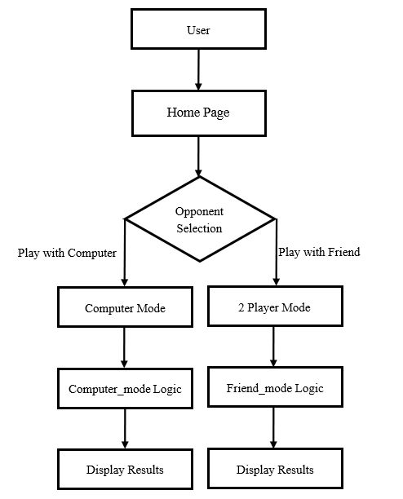
Data Flow Diagrams
Figure 1 : Data Flow Diagram

Slide 18
User – Defined Functions
getHandMove(hand_landmarks): This function takes a hand landmark object as input and analyzes the landmark positions to determine the hand gesture. It returns a string representing the detected gesture. Determines the hand gesture ("rock", "paper", or "scissors") based on the provided hand landmarks. Parameters: hand_landmarks (MediaPipe hand landmarks). Returns: A string representing the hand gesture ("rock", "paper", or "scissors").
gen(camera): Generates a video frame from the provided camera instance for streaming. Generates a video frame from the provided camera instance for streaming. Parameters: camera (an instance of VideoCamera or ComputerCamera). Yields: A video frame in a format suitable for streaming (multipart/x-mixed-replace).

Slide 19
Built - in Functions
cv2.VideoCapture(0): This function from the OpenCV library is used to initialize the video capture from the default camera (0 represents the default camera). It returns a VideoCapture object that can be used to read frames from the camera.
cv2.namedWindow('frame', cv2.WINDOW_NORMAL): This function from the OpenCV library creates a window with the specified name ('frame') and displays it with normal properties (cv2.WINDOW_NORMAL).
cv2.cvtColor(frame, cv.COLOR_BGR2RGB) and cv2.cvtColor(frame, cv.COLOR_RGB2BGR): These functions from the OpenCV library are used to convert the color space of an image between BGR (the default color space used by OpenCV) and RGB color spaces.

Slide 20
Built - in Functions
cv2.flip(frame, 1): This function from the OpenCV library flips the image horizontally (1 means flipping horizontally, 0 means flipping vertically, and -1 means flipping both horizontally and vertically).
cv2.rectangle(frame, start_point, end_point, color, thickness): This function from the OpenCV library draws a rectangle on the specified image (frame) with the given start and end points, color, and thickness.
cv2.putText(frame, text, position, font, font_scale, color, thickness, line_type): This function from the OpenCV library draws text on the specified image (frame) at the given position, with the specified font, font scale, color, thickness, and line type.

Slide 21
Built - in Functions
cv2.imshow('frame', frame): This function from the OpenCV library displays the specified image (frame) in the window created earlier with cv2.namedWindow().
cv2.getWindowProperty('frame', cv2.WND_PROP_VISIBLE): This function from the OpenCV library retrieves the specified property (cv2.WND_PROP_VISIBLE) of the window named 'frame'. In this case, it's used to check if the window is still open (< 1 means the window is closed).
cv2.waitKey(delay): This function from the OpenCV library waits for a key press event for the specified delay (in milliseconds). If the 'q' key is pressed, the script exits.
cv2.destroyAllWindows(): This function from the OpenCV library destroys all the windows created by the script

Slide 22
Code Snippets
Setting Up MediaPipe Hands:
First, initialize MediaPipe Hands and related drawing utilities
import cv2 as cv
import mediapipe as mp
import threading
import random
# Initialize MediaPipe Hands
mp_drawing = mp.solutions.drawing_utils
mp_drawing_styles = mp.solutions.drawing_styles
mp_hands = mp.solutions.hands

Slide 23
Code Snippets
2. Hand Gesture Detection Function
This function determines the gesture based on the landmarks of the detected hand.
def getHandMove(hand_landmarks):
landmarks = hand_landmarks.landmark
# Check for "rock"
if all([landmarks[i].y < landmarks[i+3].y for i in range(9, 20, 4)]):
return "rock"
# Check for "scissors"
elif landmarks[13].y < landmarks[16].y and landmarks[17].y < landmarks[20].y:
return "scissors"
# Default to "paper"
else:
return "paper"

Slide 24
Code Snippets
3. Game Logic – 2 Player Mode
hls = results.multi_hand_landmarks
if hls and len(hls) == 2:
self.p1_move = getHandMove(hls[0])
self.p2_move = getHandMove(hls[1])
if self.p1_move == self.p2_move:
self.gameText += " Game is tied."
elif self.p1_move == "paper" and self.p2_move == "rock":
self.gameText += " Player 1 wins."
elif self.p1_move == "rock" and self.p2_move == "scissors":
self.gameText += " Player 1 wins."
elif self.p1_move == "scissors" and self.p2_move == "paper":
self.gameText += " Player 1 wins."
else:
self.gameText += " Player 2 wins!"

Slide 25
Code Snippets
4. Game Logic – 1 Player Mode
if hls and len(hls) == 1:
self.player_move = getHandMove(hls[0])
self.computer_move = random.choice(["rock", "paper", "scissors"])
self.gameText = f'''Player played {self.player_move}. Computer played {self.computer_move}.'''
if self.player_move == self.computer_move:
self.gameText += " Game is tied."
elif self.player_move == "paper" and self.computer_move == "rock":
self.gameText += " Player wins."
elif self.player_move == "rock" and self.computer_move == "scissors":
self.gameText += " Player wins."
elif self.player_move == "scissors" and self.computer_move == "paper":
self.gameText += " Player wins."
else:
self.gameText += " Computer wins!"

Slide 26
Results
Project Overview:
RockNet is a real-time Rock-Paper-Scissors game.
Implemented using Python libraries for computer graphics and image processing.
Application of Techniques:
Demonstrates the use of computer vision for real-time hand pose estimation.
Integrates these techniques with game development principles.
Game Logic:
Adheres to traditional Rock-Paper-Scissors rules to determine the winner.
Displays the results based on the recognized gestures.
User Experience:
Offers an interactive and engaging experience for playing Rock-Paper-Scissors using hand gestures.

Slide 27
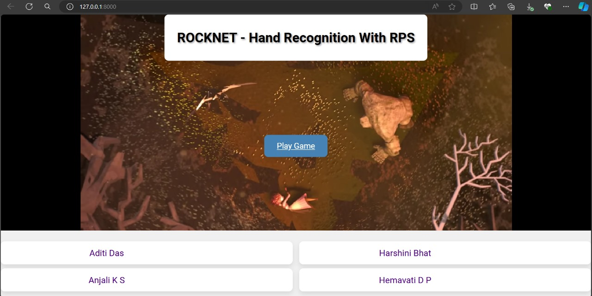
Results
Figure 2 : Home Page of ROCKNET – Hand Recognition with RPS

Slide 28
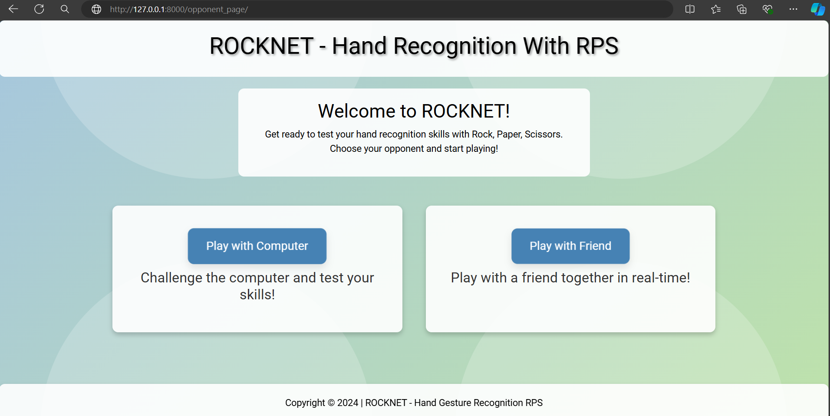
Results
Figure 3 : Opponent Select page of ROCKNET – Hand Recognition with RPS

Slide 29
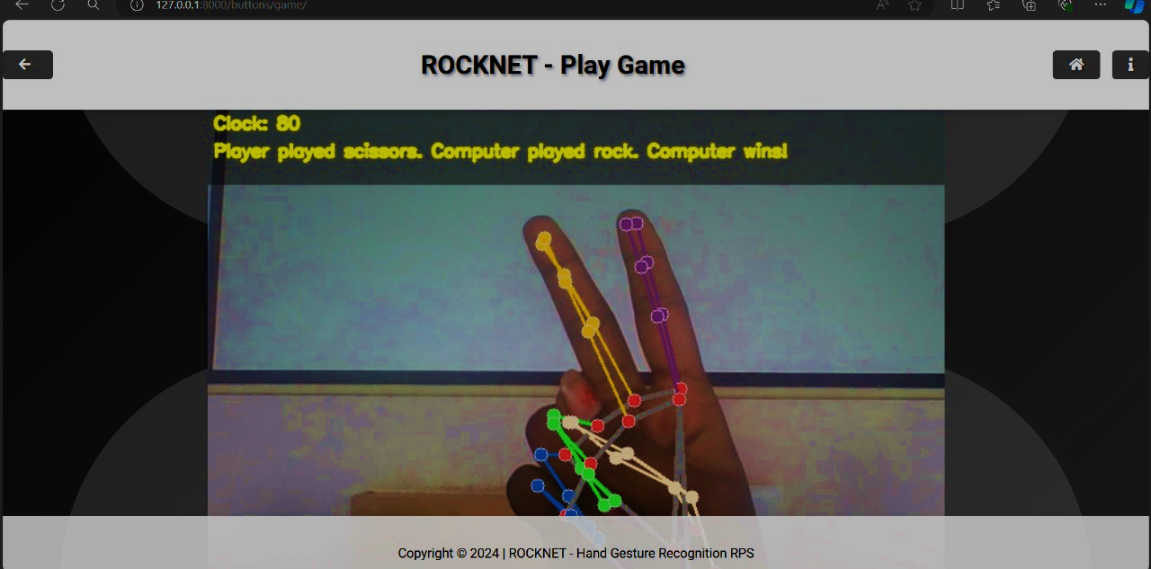
Results
Figure 4 : Play with Computer page of ROCKNET – Hand Recognition with RPS

Slide 30
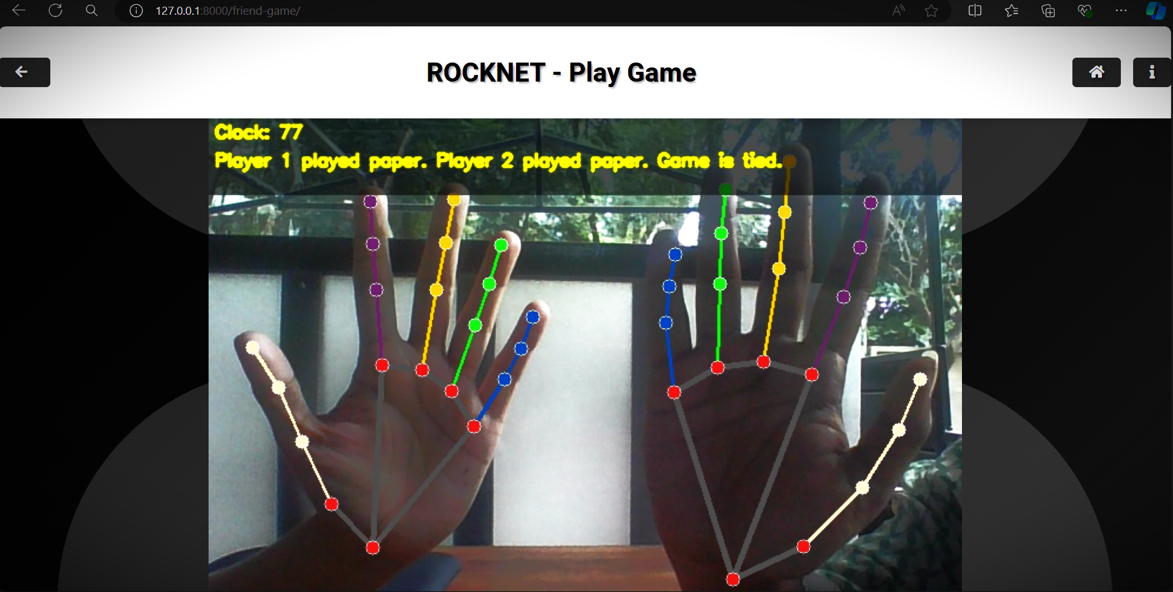
Results
Figure 5 : Play with friend window of ROCKNET – Hand Recognition with RPS

Slide 31
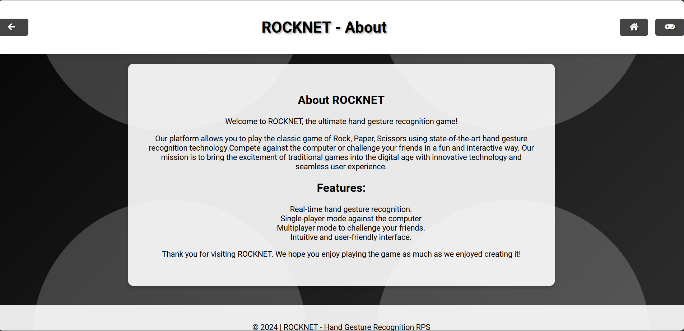
Results
Figure 6 : About page of ROCKNET – Hand Recognition with RPS

Slide 32
Applications
32
Educational Tool: RockNet can be a gamified tool for teaching children or those new to Rock-Paper-Scissors the game rules and hand signs. The visual feedback and interactive nature can make learning more engaging.
Human-Computer Interaction: RockNet can serve as a foundation for developing more complex hand gesture recognition interfaces for computer control. Imagine using hand gestures to navigate menus, control games, or interact with virtual reality environments.
Entertainment: The core concept of RockNet can be extended to create other interactive hand gesture-based games, promoting physical activity and social interaction.
32

Slide 33
Advantages
Real-Time and Contactless: RockNet provides a real-time and contactless way to play Rock-Paper-Scissors, eliminating the need for physical contact between players, which can be beneficial in hygiene-conscious settings.
Engaging and User-Friendly: The interactive interface with visual feedback and a countdown timer makes the game more engaging and user-friendly compared to a traditional game.
Easy to Set Up and Use: The use of Python libraries like MediaPipe simplifies development and potentially lowers the barrier to entry for those interested in exploring hand gesture recognition.
Customizable: RockNet's core functionalities can be customized to create variations of the game or integrate it with other applications. For instance, one could implement a single-player mode against a computer opponent or develop a Rock-Paper-Scissors tournament system.

Slide 34
Future Enhancements
Enhanced Gesture Recognition:
Implement advanced machine learning models for more accurate hand pose estimation and gesture recognition.
Include support for additional gestures and hand poses to expand game functionality.
Multiplayer Online Mode:
Develop an online multiplayer mode allowing players to compete remotely.
Integrate real-time communication features such as voice and video chat.
Augmented Reality (AR) Integration:
Incorporate AR elements to provide a more immersive gaming experience.
Allow players to see virtual game elements overlaid on their physical environment.

Slide 35
Future Enhancements
Multiplayer Online Mode:
Develop an online multiplayer mode allowing players to compete remotely.
Integrate real-time communication features such as voice and video chat.
Augmented Reality (AR) Integration:
Incorporate AR elements to provide a more immersive gaming experience.
Allow players to see virtual game elements overlaid on their physical environment.

Slide 36
Conclusion
RockNet effectively showcases the application of computer vision techniques in an interactive and engaging manner. By leveraging MediaPipe's hand detection model, the system accurately recognizes hand gestures from webcam input, allowing users to play Rock-Paper-Scissors in real-time. The integration of real-time hand pose estimation with game development principles not only highlights the potential of these technologies but also offers a practical and fun use case. The project successfully demonstrates the capability of modern computer vision tools to create interactive applications, providing a compelling user experience through its adherence to traditional game rules and real-time feedback..

Slide 37
References
[1] MediaPipe Hands - Official documentation and guides on using MediaPipe Hands.
[2] Hand Gesture Recognition using MediaPipe - A detailed tutorial on building a hand gesture recognition system using MediaPipe and OpenCV.
[3] Build a Rock Paper Scissors Game with Hand Tracking in Python - A step-by-step guide on creating a Rock-Paper-Scissors game with hand tracking using Python, OpenCV, and MediaPipe.

Slide 38
THANK YOU

